Slide 1
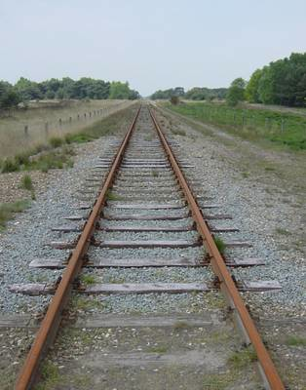
ONE POINT PERSPECTIVE
Surfaces that travel away from the viewer, on the other hand, converge towards a single ‘vanishing point‘. This is a point that is located directly in front of the viewer’s eyes, on a ‘horizon line’ (also known as an ‘eye level line’), as illustrated in the photo below:

Slide 2
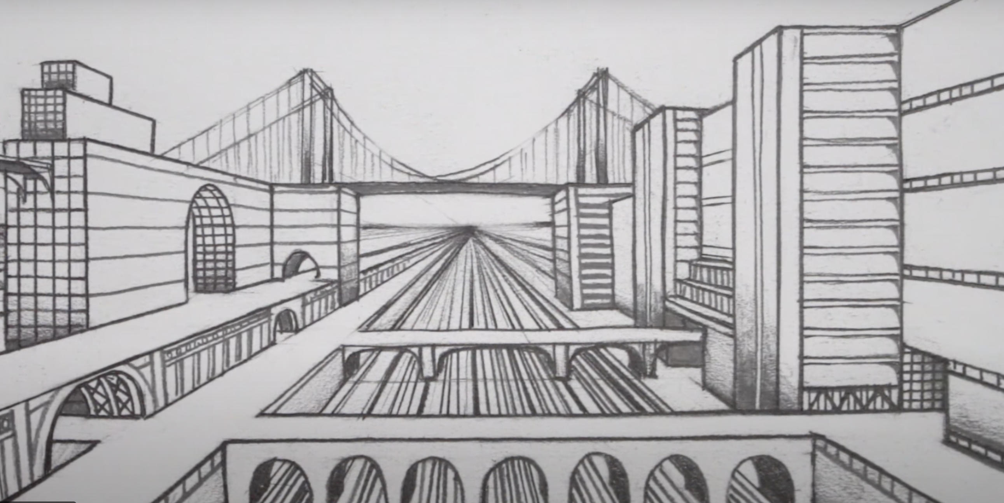

Slide 3
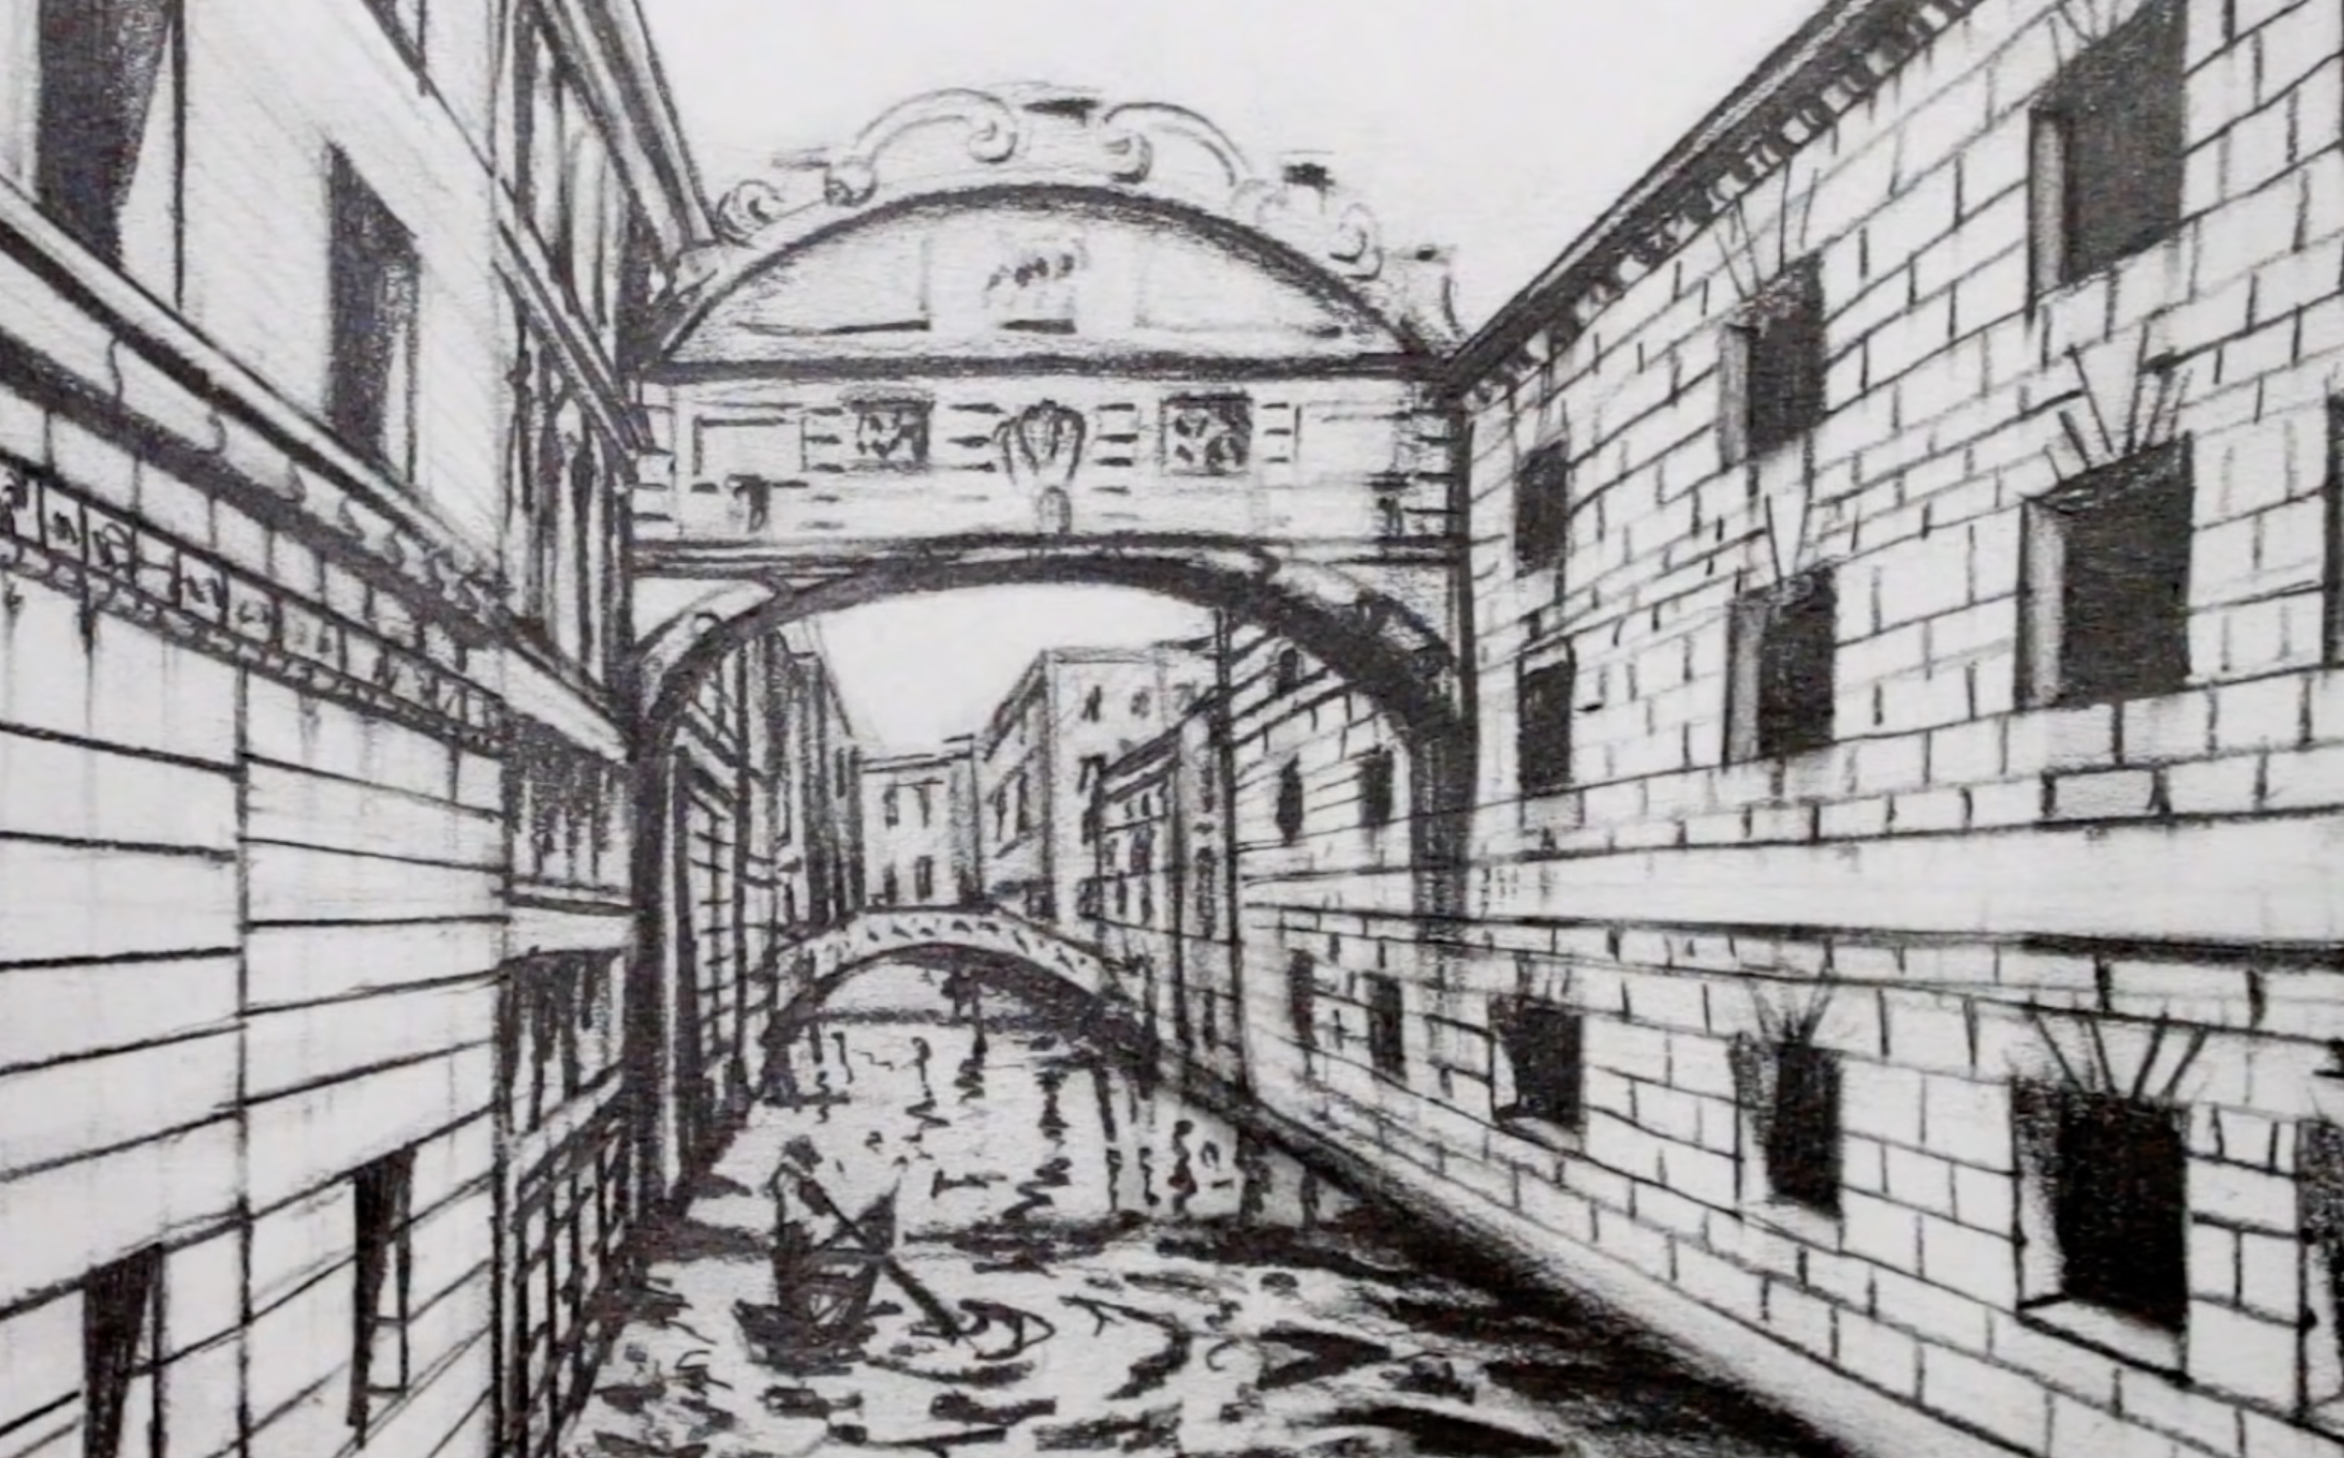

Slide 4
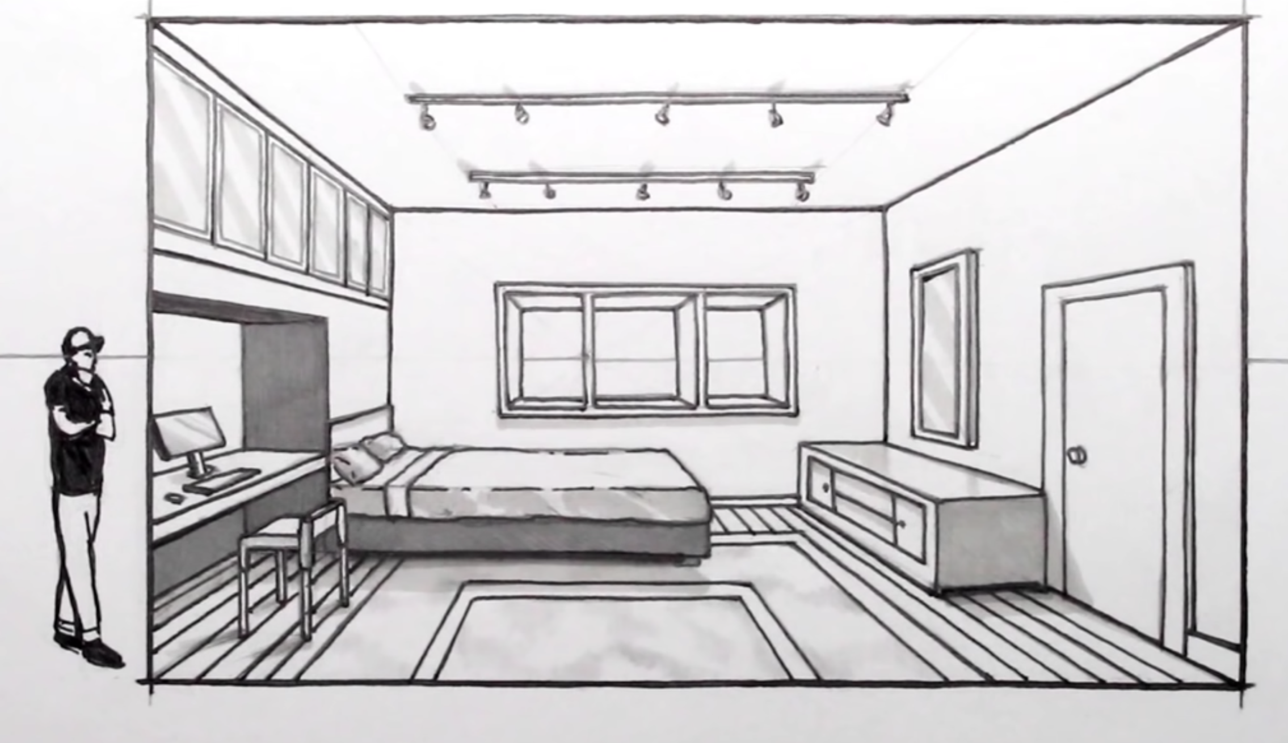

Slide 5
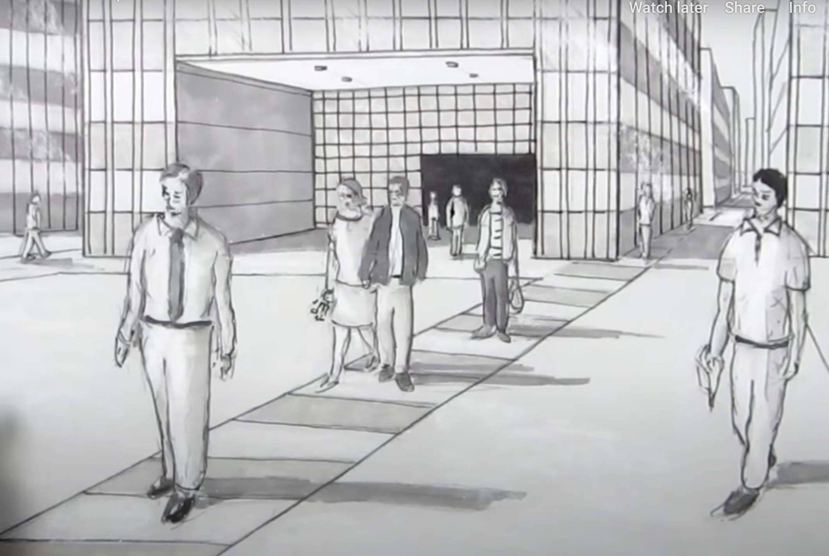

Slide 6
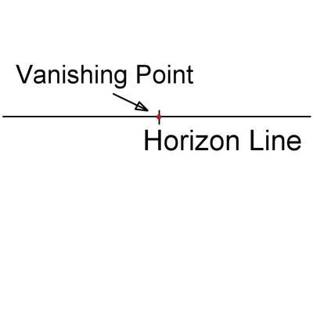
Notes:
Let's draw a simple box using one-point perspective. First, draw a horizon line about one-third down your page. Use a small dot or line to mark a spot roughly in the middle of the line. That's your vanishing point. (Don't make it as big as this example - you want it to be small, so that all your lines finish in exactly the same spot.)

Slide 7
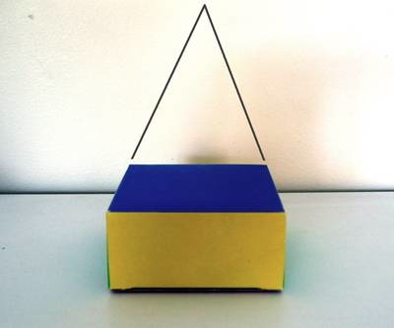
Notes:
Notice that the back of the box - which you know is the same size as the front - looks narrower from this point of view.

Slide 8
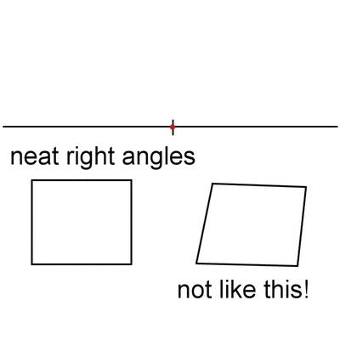
Notes:
Now draw square or rectangle, well below and to one side of your vanishing point. Make sure your vertical lines are perpendicular (at right angles) to your horizon line, and your horizontal lines are parallel. No funny angles or wobbly lines! For a successful perspective drawing, you need straight lines and corners that meet exactly.

Slide 9
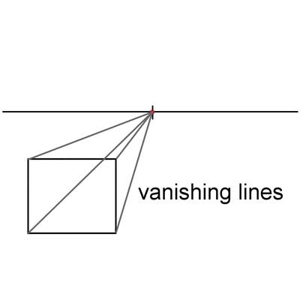
Notes:
Now draw a line from each corner of your square or rectangle to the vanishing point. Make sure they are straight and finish exactly at the vanishing point. In perspective drawing, we call these lines orthogonal lines or orthogonals, which is derives somewhat from their meaning in mathematics (because they are at right angles to the horizontal plane).

Slide 10
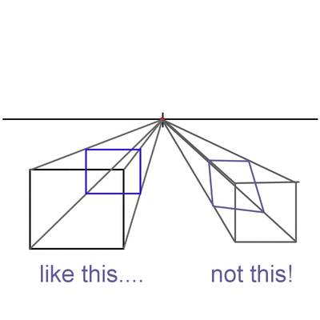

Slide 11
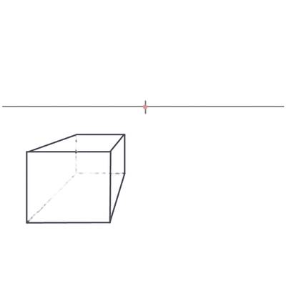
Notes:
Now that you have finished constructing the box, you can erase the vanishing lines. You can keep all the lines inside the box if you want it to be see-through, like a fishtank, or, you can carefully erase the back corner - the bottom left, back, and lower back lines, as I have done in this example.

Slide 12
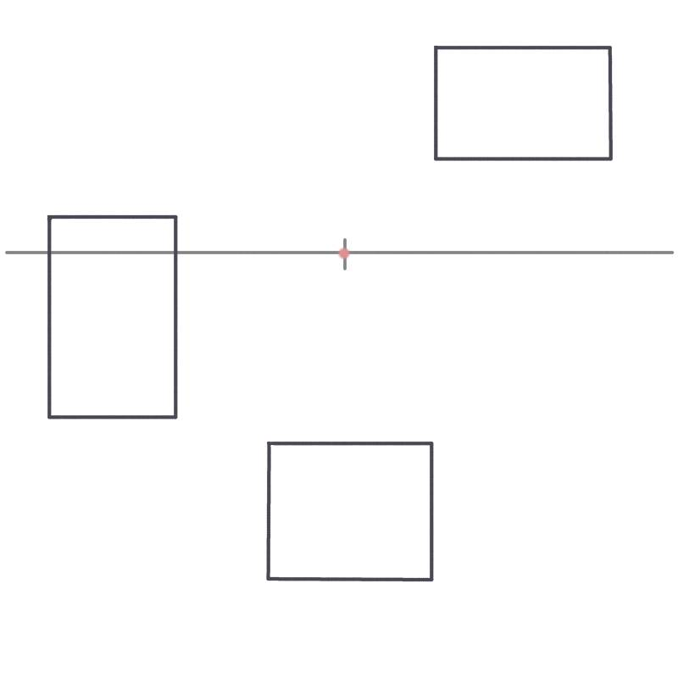

Slide 13
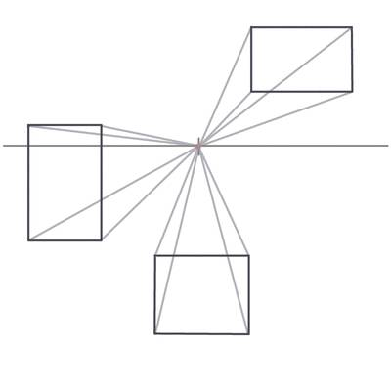

Slide 14
