Slide 1

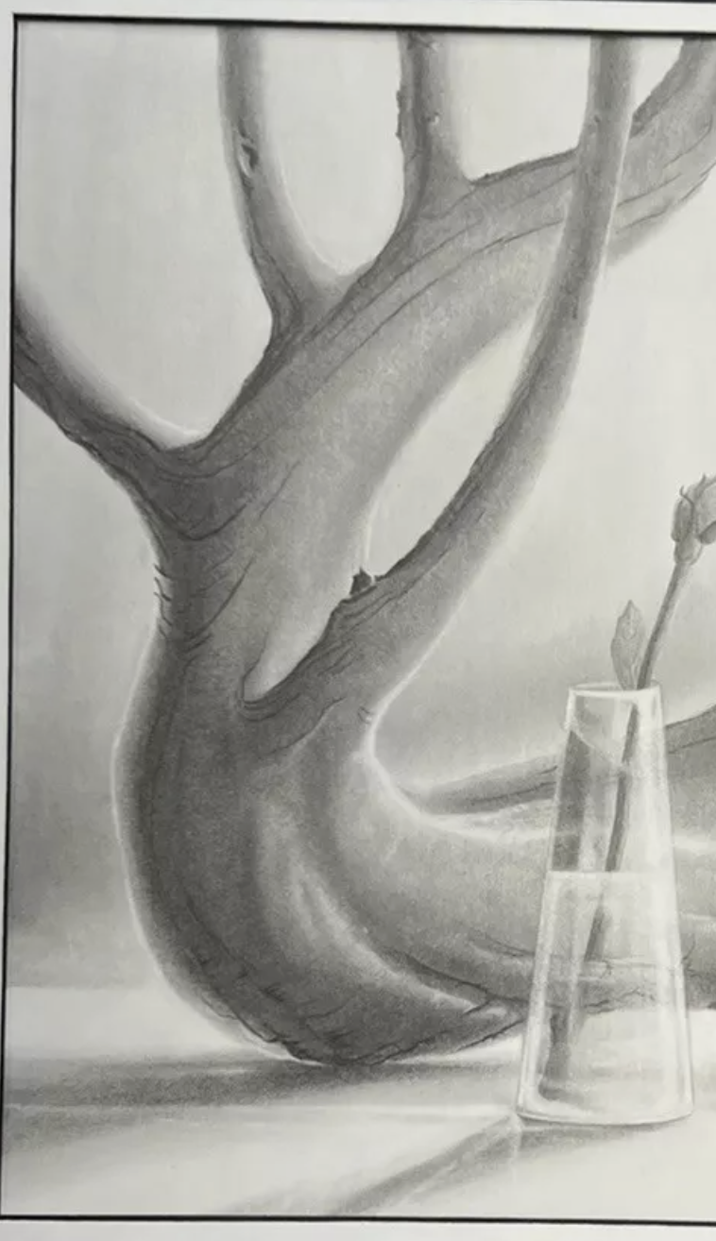
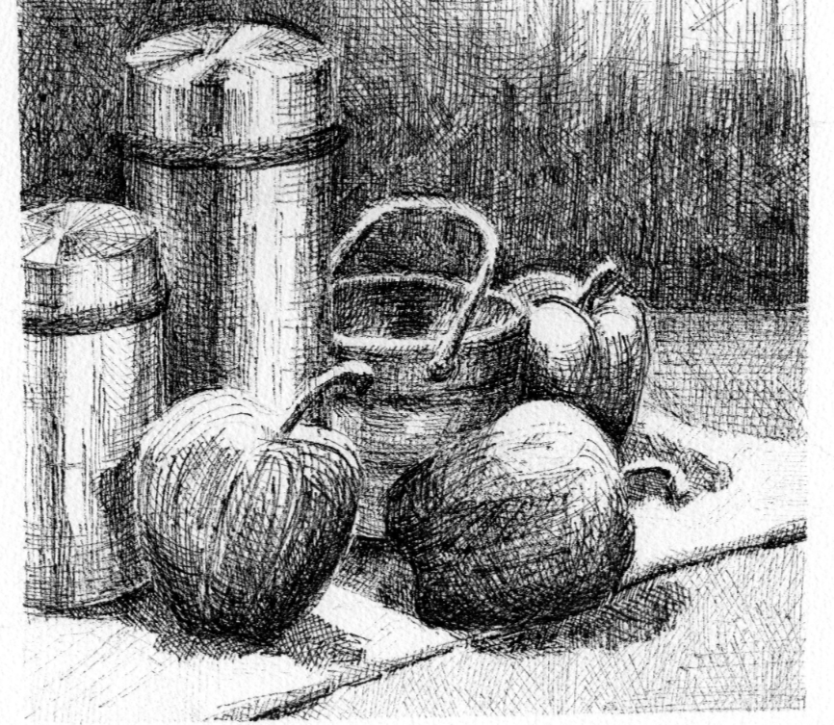
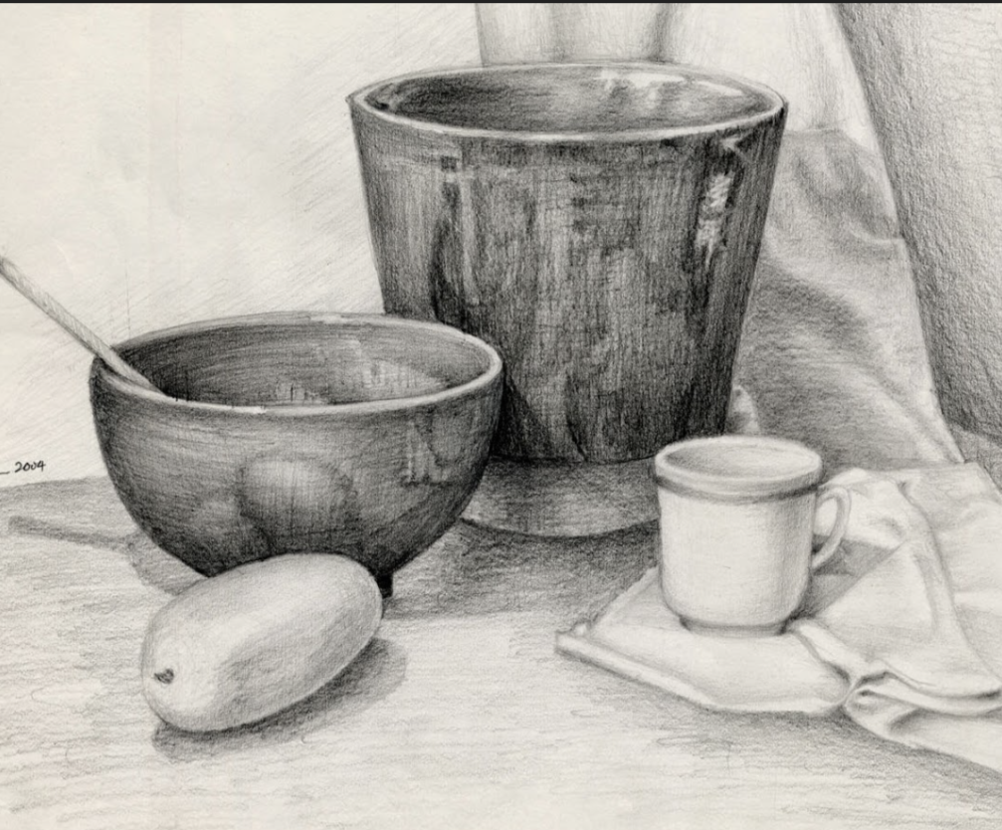
Mid Drawing Reflection
Open your sketchbook to your value scale.
Complete the self reflection.
For #3 Refer to your value scale to count the number of values in your drawing.
For #6 Refer to the goals you wrote in your sketchbook.

