Slide 1

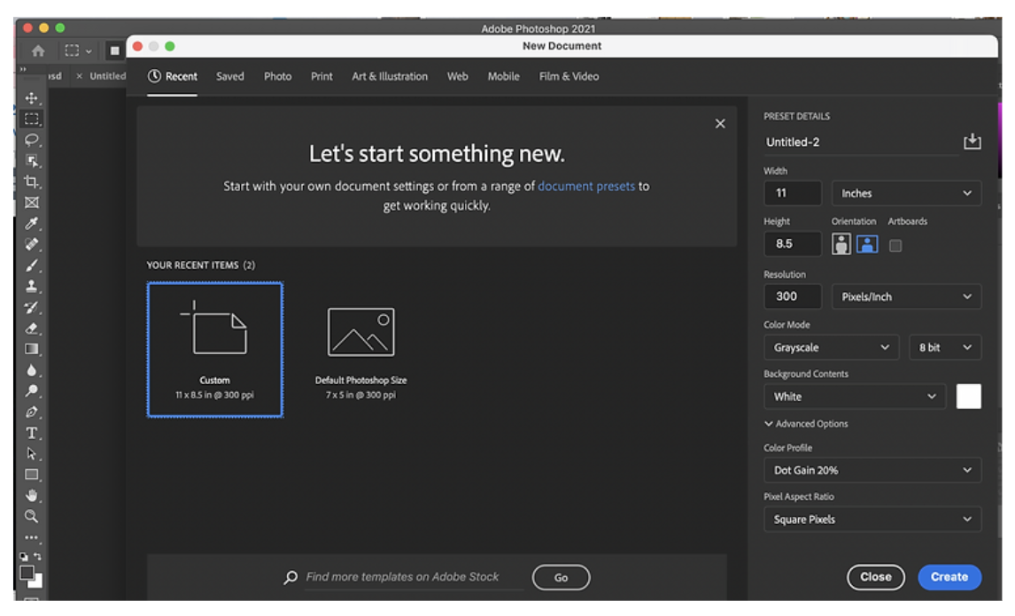
Preparing your photo -Photo-Shop Mini Lesson

Slide 2
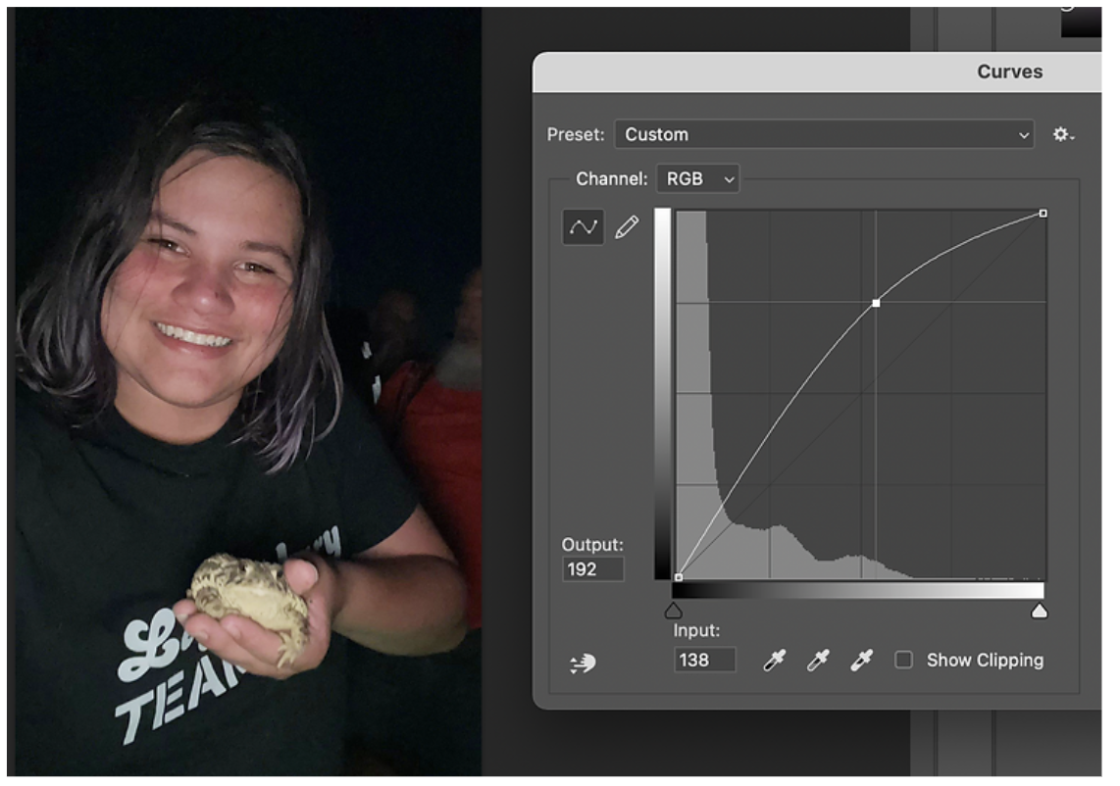
Use “Curves” to Brighten your photo.
To access Curves in Photoshop, you can either go to Image >> Adjustments >> Curves, or press “command” and “M” at the same time. A little graph will pop up, like the one below. To brighten your photo, just drag the line on the graph slightly higher, similar to what mine looks like below. You don’t need to drag it very far to start seeing great results! When you like the brightness, click “OK.”
Quick Tip: If you’re not seeing any changes, then make sure the “Preview” button is checked.

Slide 3
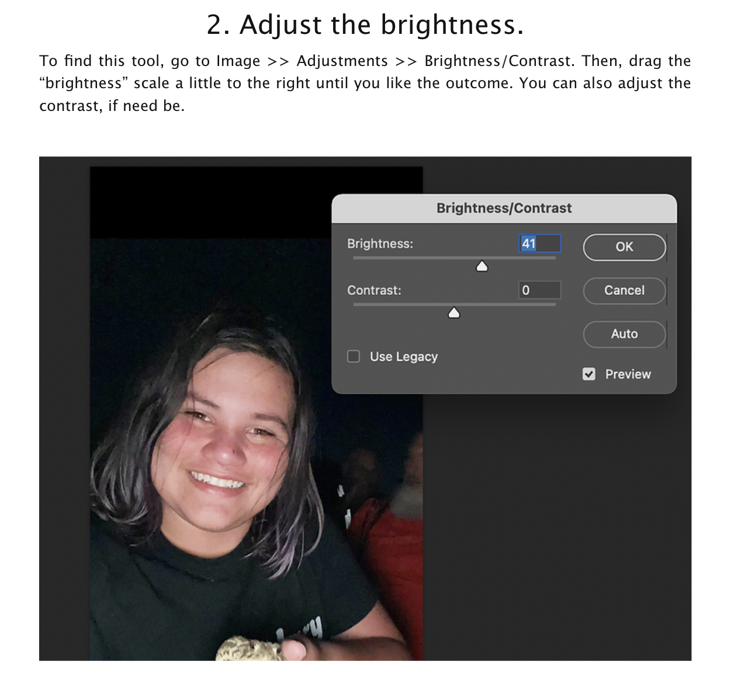

Slide 4
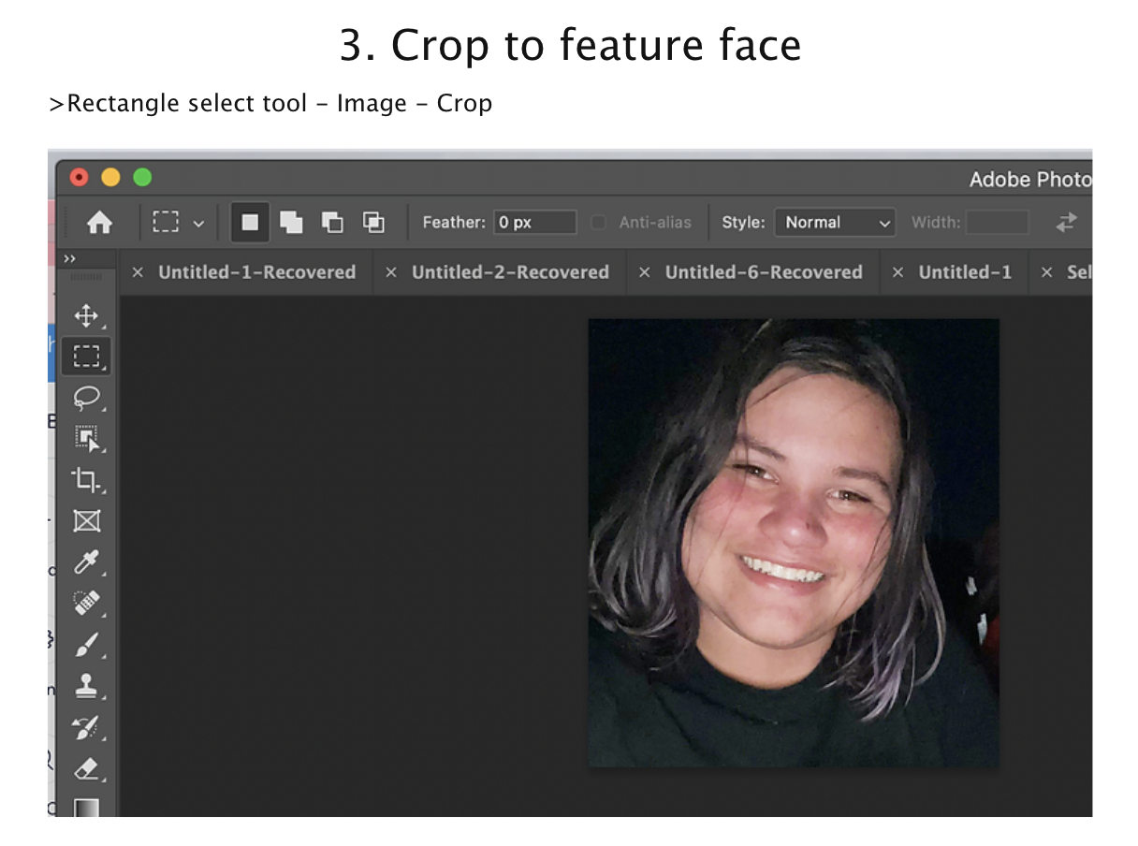

Slide 5
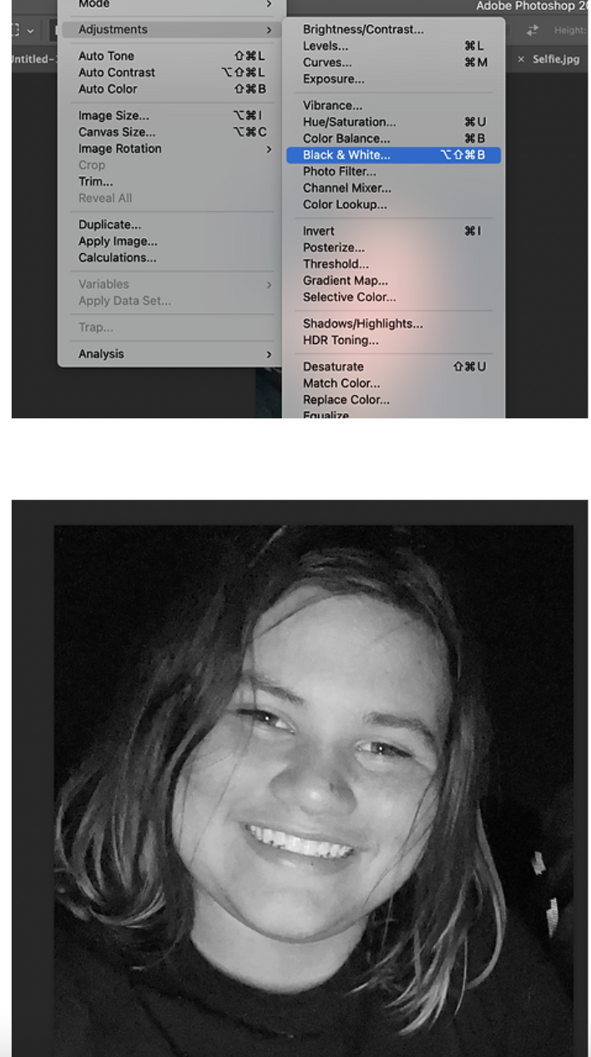
4. Change to Black + White

Slide 6
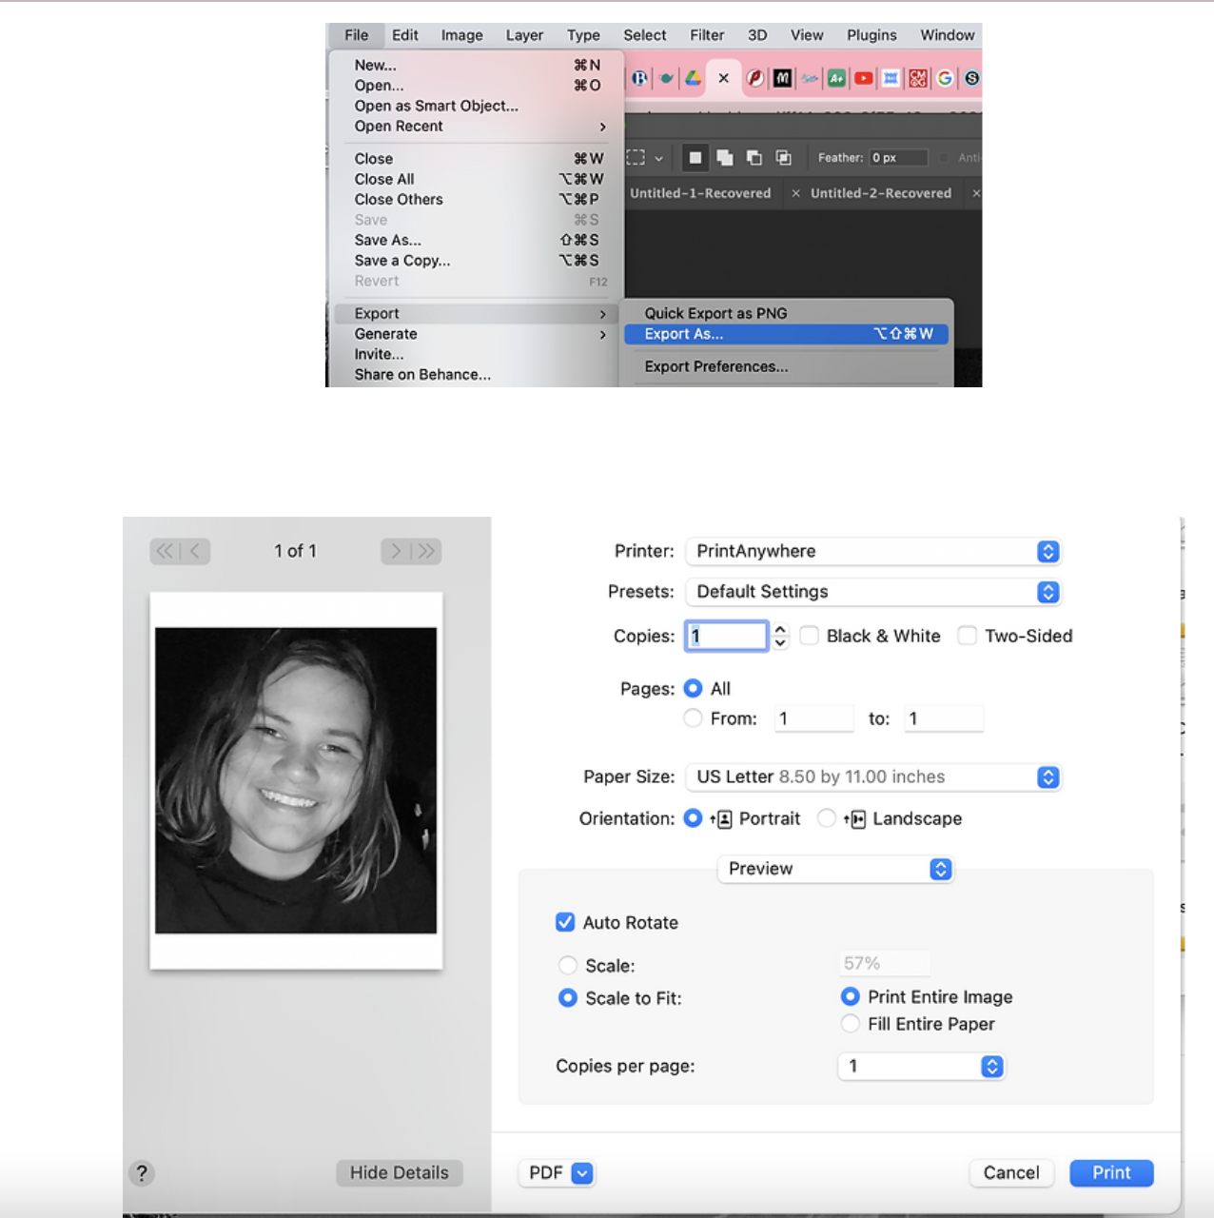

Slide 7
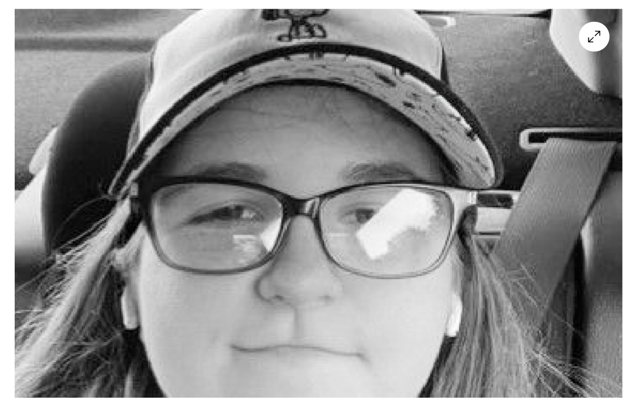
REMOVE GLARE FROM GLASSES
Watch this Adobe Video - https://www.youtube.com/watch?v=AWUMrhvaNqs

