Slide 1
CRITIQUE PROCESS
MAKE TEST REVISE

Slide 2
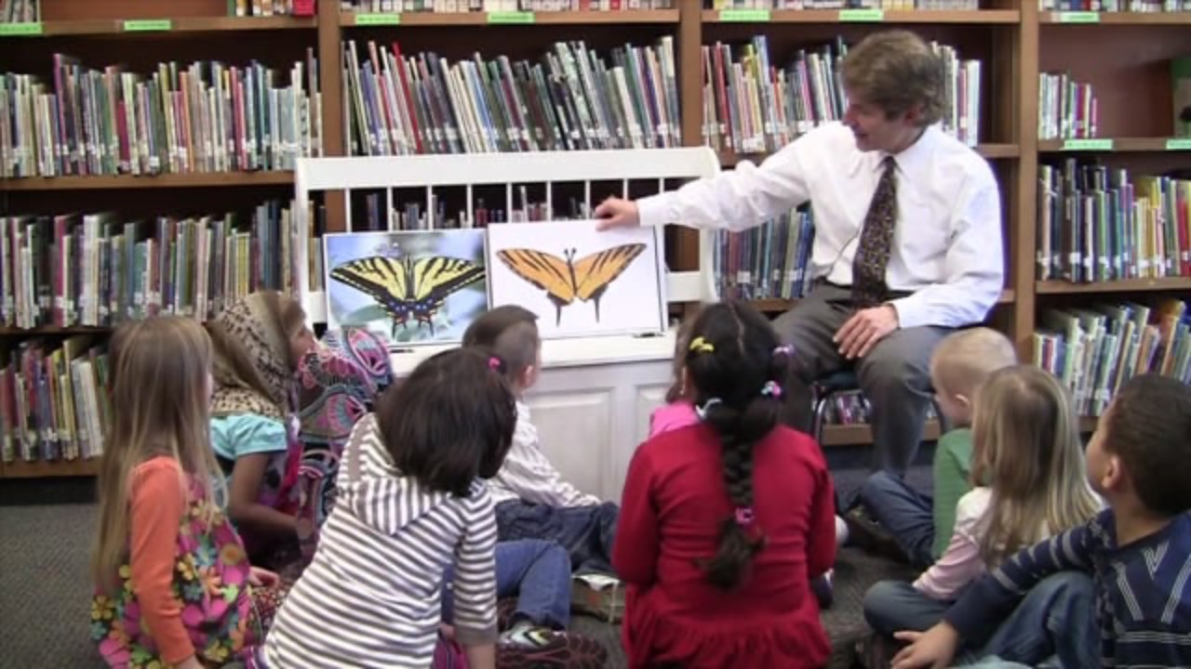
AUSTIN’S BUTTERFLY

Slide 3
TAKE AWAYS:

Slide 4
AT YOUR TABLE:
Round Robin guided critique. Start with a volunteer to share first.
2 min. Share your work, 1 success then 1 struggle
2 min. Yellow hat feedback – What’s working?
2 min. Green hat feedback – Have you considered? What would happen if?
REVISION 1 CONSIDER:
Composition – is the layout working to fill the space in a balanced way?
Proportion/Scale- how do parts relate to each other in terms of size?
Are all the essential parts included or missing?

Slide 5
REVISION 2 Round Robin guided critique. Start with a volunteer to share first.
2 min. Share your revision.
2 min. Yellow hat feedback – What’s working?
2 min. Green hat feedback – Have you considered? What would happen if?
CONSIDER:
Space – are detailed parts in the right places?
Pattern- how do realistic patterns of the insect translate in the drawing?
Color – are colors accurate and applied in a manner that creates realistic textures and patterns?

Slide 6
REVISION 3 Round Robin guided critique. Start with a volunteer to share first.
2 min. Share your revision.
2 min. Yellow hat feedback – What’s working?
2 min. Green hat feedback – Have you considered? What would happen if?
CONSIDER:
Craftsmanship – Is the page clean and free of smudges, spots, tears? Is lettering neat?

