Slide 1
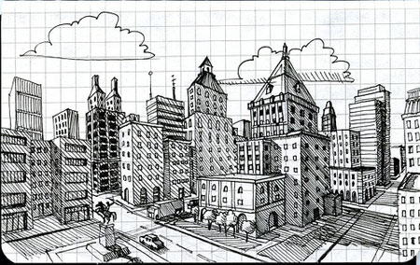
Design Challenge:
Build a city block of your dream utilizing two point perspective!

Slide 2
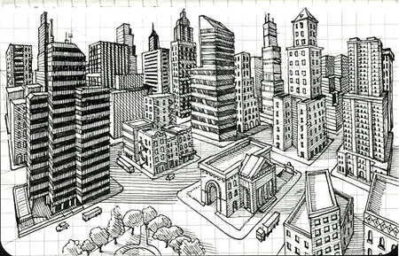

Slide 3
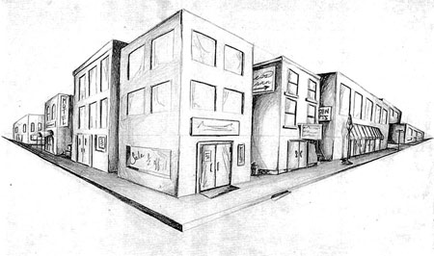

Slide 4
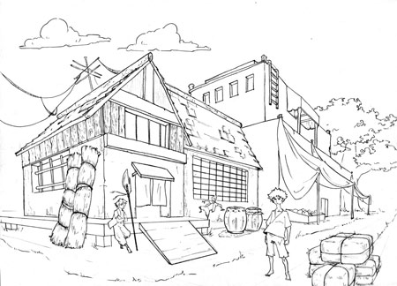
Consider the style or time period you would like to depict. Will it be urban modern? ​
Small town Midwestern? Medieval? Turn of the century? Futuristic? ​
It’s up to you -as long as you meet the base requirements.

Slide 5
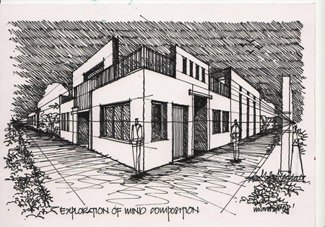
For inspiration, do your own visual research with search terms like "two point perspective modern building" or "two point perspective medieval" or "two point perspective village". You may also base your drawing on a real city – perhaps somewhere you have visited – or would like to go.
You can draw inspiration from other’s drawings – but do not copy.

Slide 6
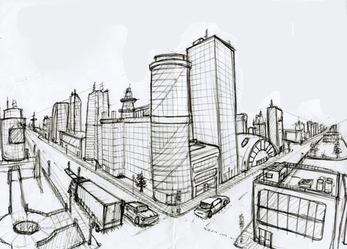
ASSIGNMENT (25 PTS)
Design a city block using 2 point perspective.
Your drawing should include at least :
Intersection of 2 streets with sidewalks
Five buildings
All buildings should have windows and doors
Include 3 special features (people, trees, a fountain, vehicle, signs with words or graphics etc.) of your choice
You can use real cities for architectural inspiration- or invent your own – be creative but be accurate with your perspective!

Slide 7
Evaluation Rubric (Mastery Project 25pts)​
​
2-point Perspective Accuracy (5 pts)​​
Horizon line (eye level) with two vanishing points are accurately implied; accurate technical drawing using perspective-vertical lines of cubic forms are truly vertical; orthogonal lines are accurately drawn to VPs.​​
​
Composition & Design Elements (5 pts)​ ​
Drawing is balanced with at least 5 buildings; design fills the page with some border at the sides; there is visual interest throughout with minimum of 1 street intersection, 2 sidewalks, doors, windows, and at least three other unique design components in 1-pt perspective (such as stairs, signs, cross walk, lights, etc.) Add’l details encouraged.​​
​
Scale & Space (5 pts)​​
All details related to a consistent implied human size. Objects accurately change in scale as they recede; spaces between objects become smaller as they recede​​
​
Pencil Technique & Craftsmanship (5 pts)​​
Lines are straight and controlled. Any shaded/colored areas are smooth, consistent and blended. Lines were drawn light enough to erase without “ghost lines.” Eraser was used to erase or minimize stray marks. Paper is flat and free of bends, tears, and smudges. ​​
​
Critique & Reflection (5 pts)​​
Student developed skills through practice and is able to articulate concepts and techniques utilizing appropriate terminology; gives & receives feedback, willing to revise and achieve accuracy. Feeback is specific, kind and helpful.​

Slide 8
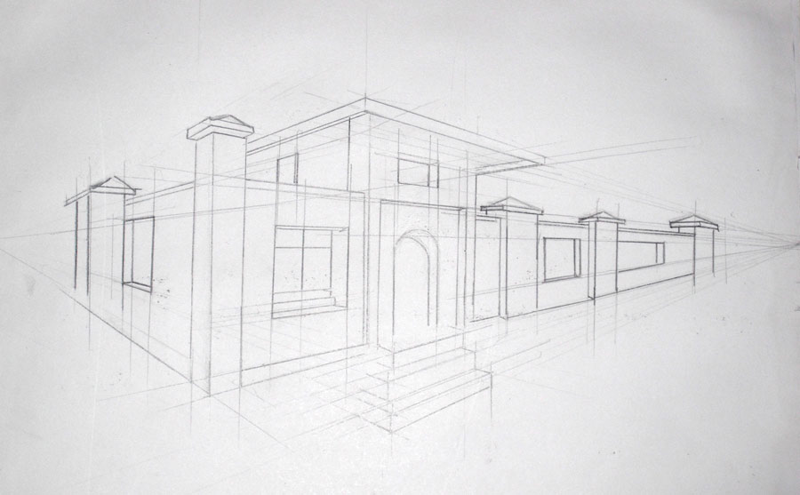
Remember, that in 2 point perspective: all vertical lines stay vertical all horizontal lines go to one of the vanishing points
All windows, doorways, and other architectural elements should follow the same rule. Look at the picture below: all lines are either vertical or go to one of the vanishing points.

Slide 9
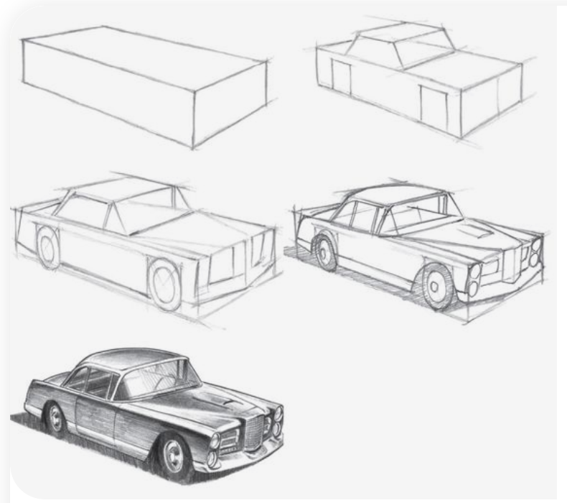
All elements of your drawing should follow two point perspective rules.
Build within a box framework starting with the vertical corner closest to you.
TIPS: DRAW ALL GUIDELINES LIGHTLY AND ERASE AS YOU NO LONGER NEED THEM.

Slide 10
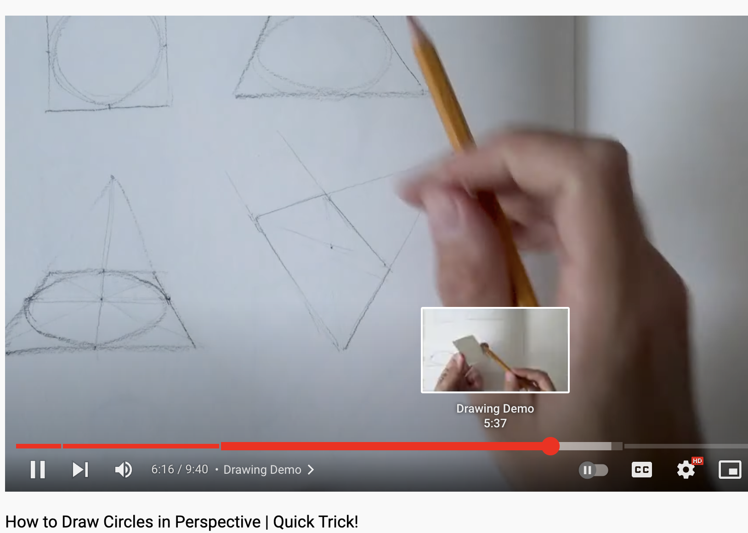
Drawing Perspective Circles + Curves

Slide 11
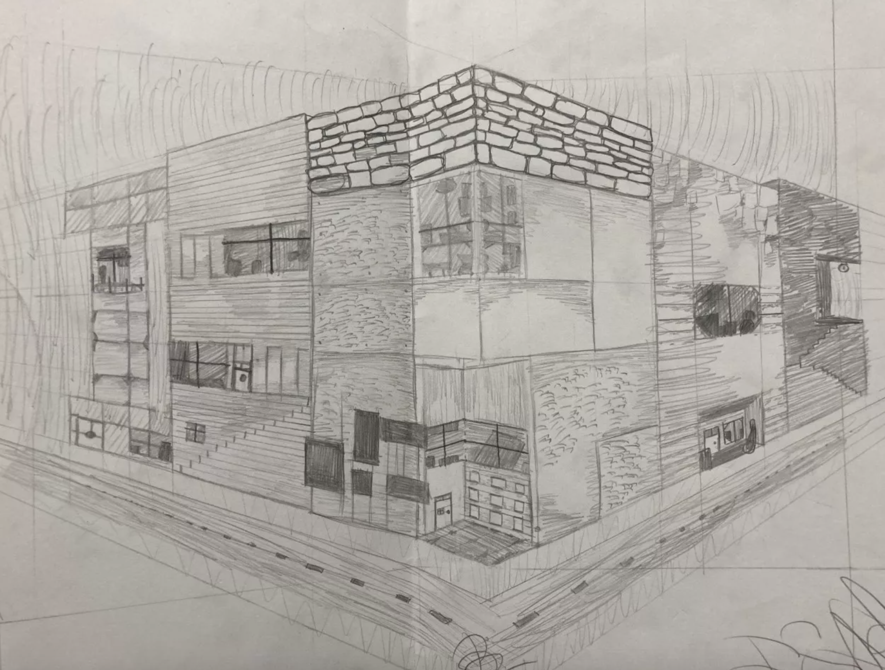
Inventive student example
Issaac

Slide 12
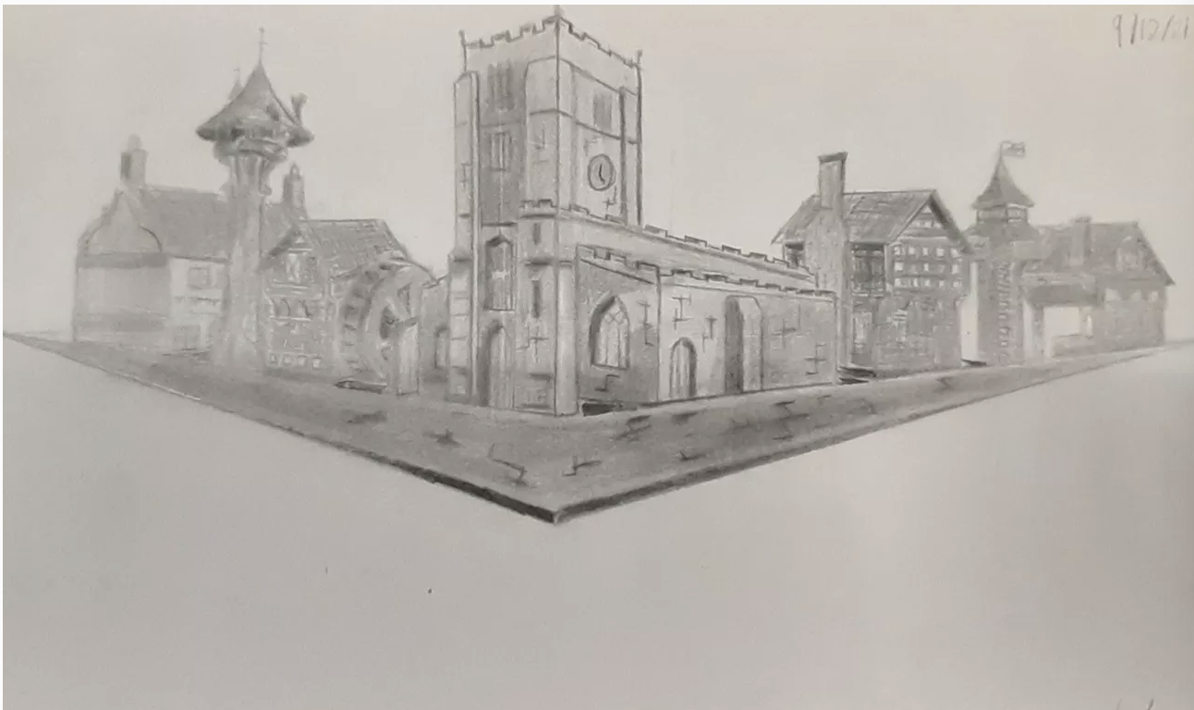
Period Student example
Chris

Slide 13
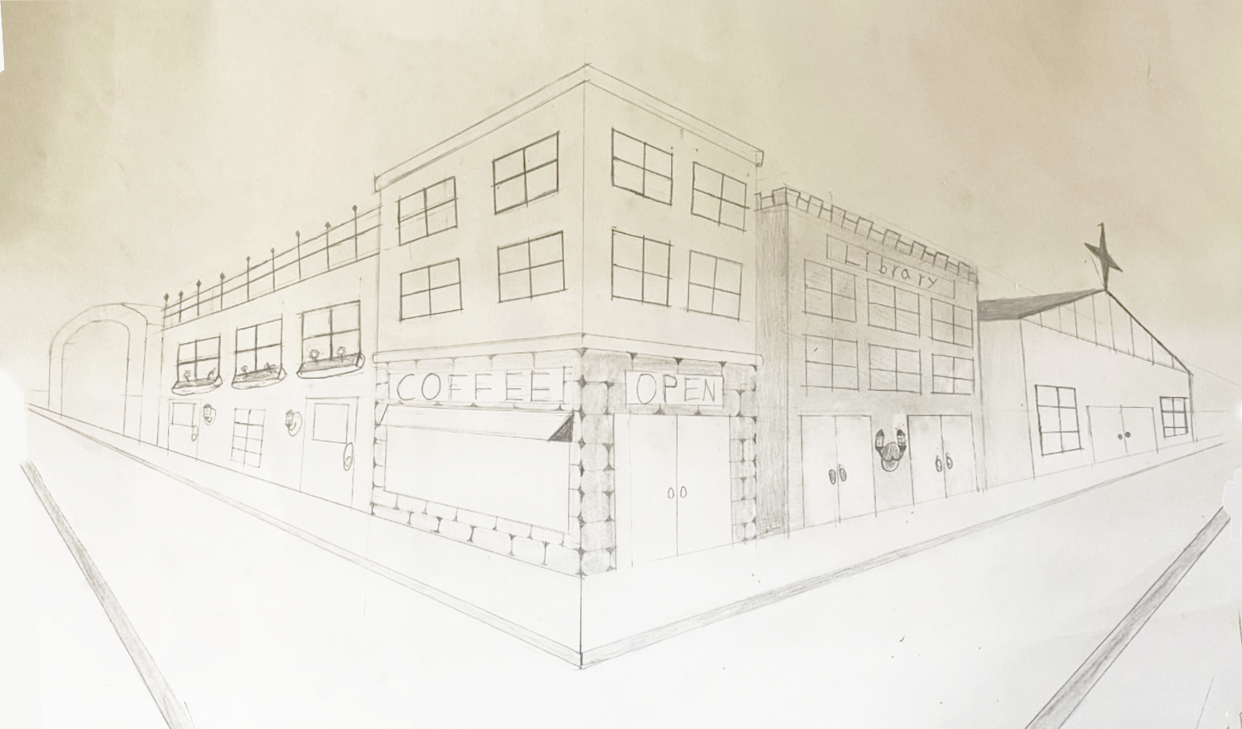
Strong Student Example

Slide 14
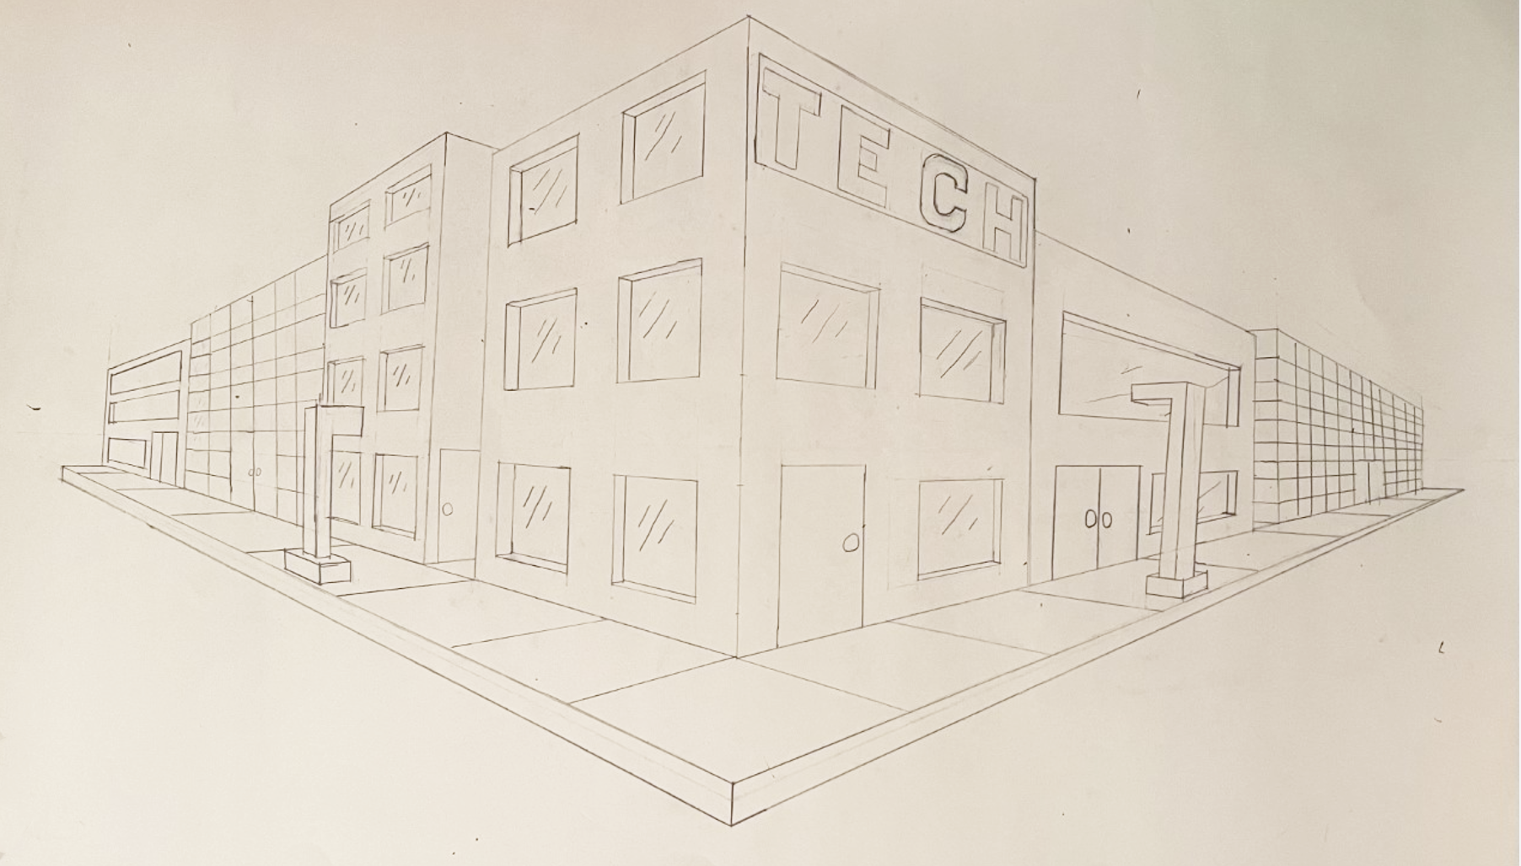
Strong Student Example

Slide 15
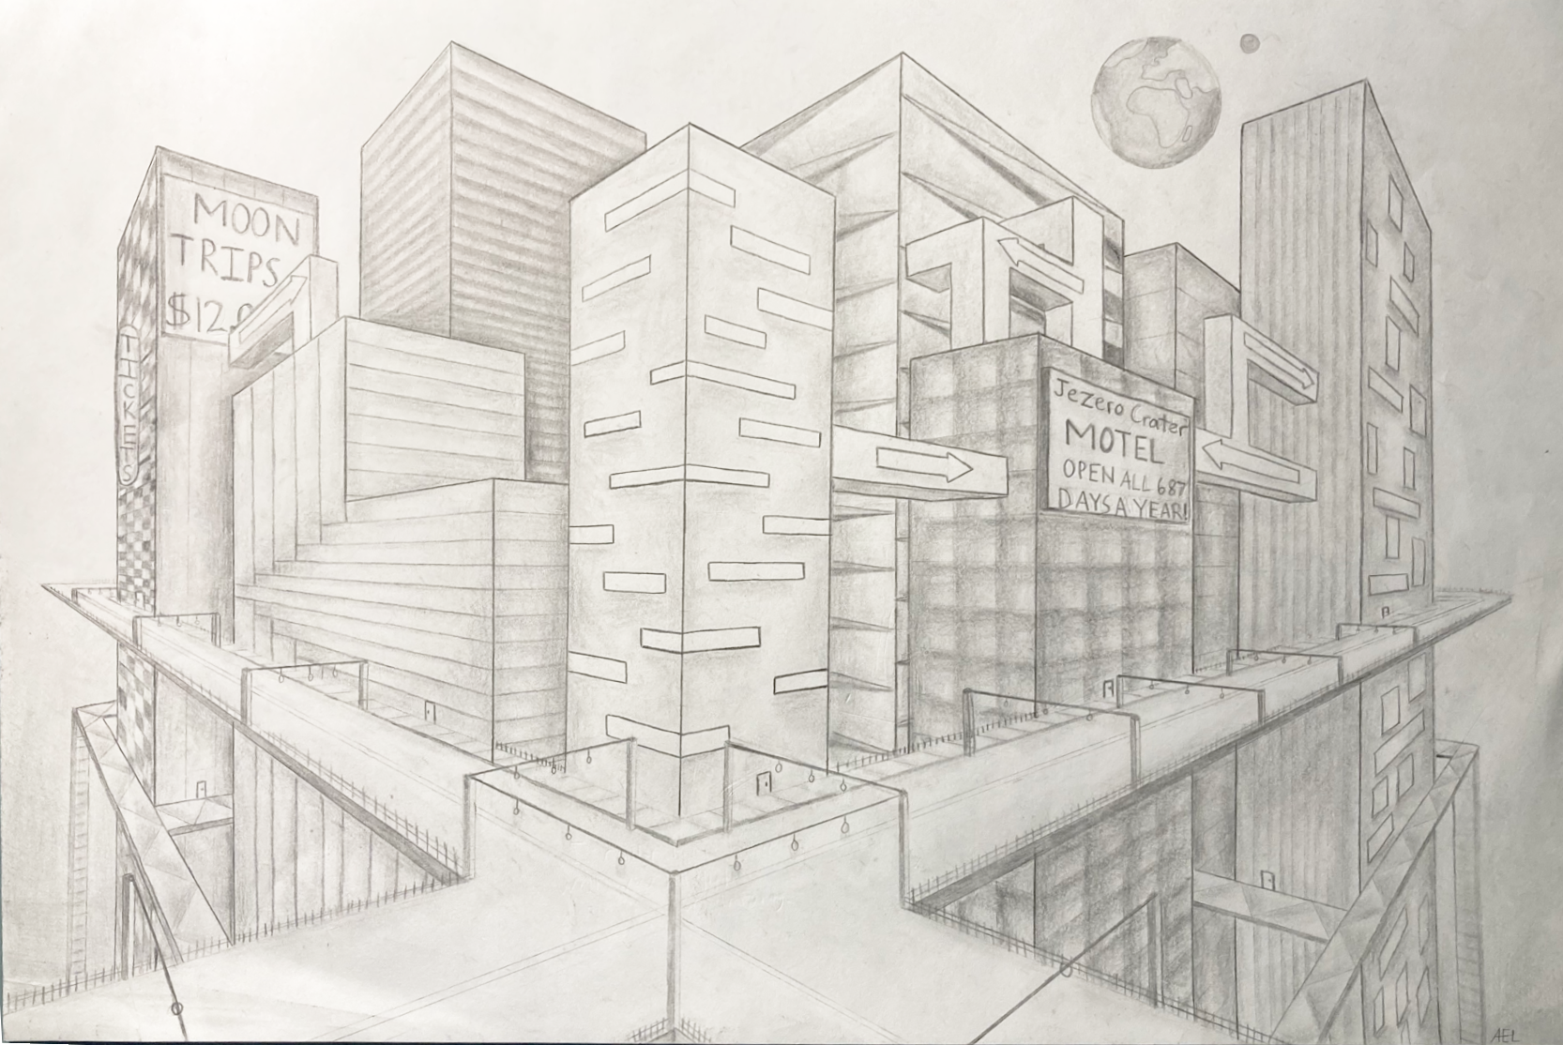
Exceptionally Skilled Student Example

Slide 16
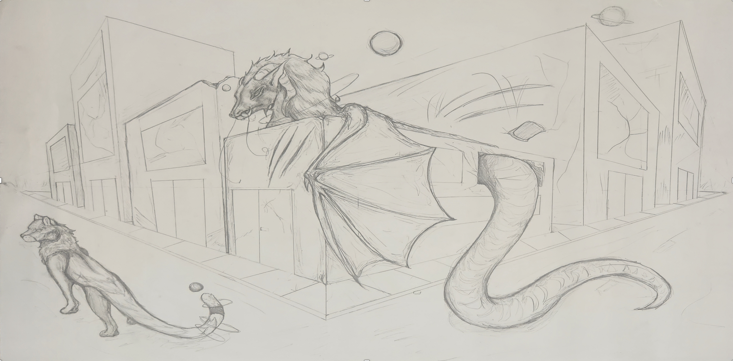
Exceptionally Creative Student Example

Slide 17
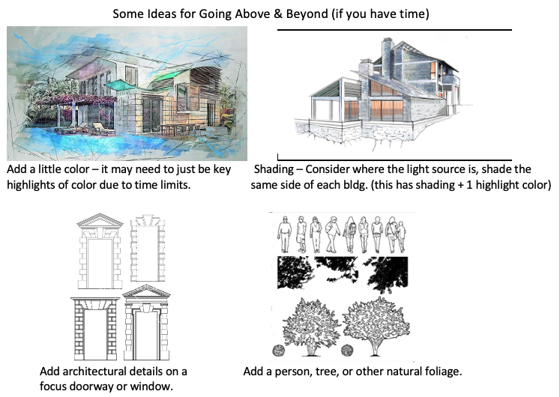
Above & Beyond

