Slide 1
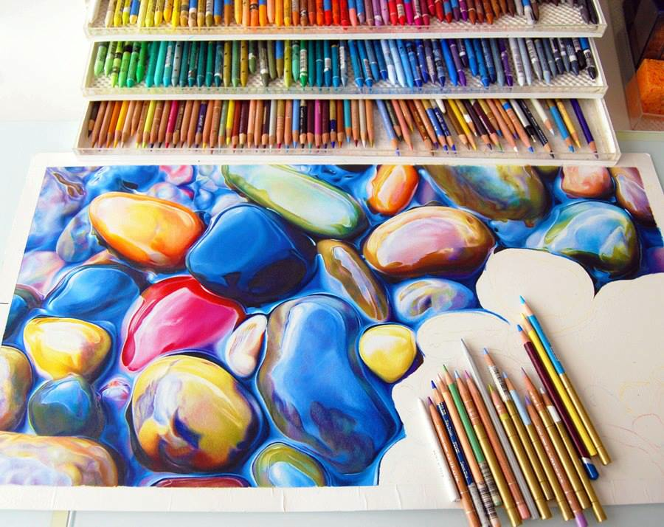
Colored pencil studies
Notes:
Also good resource: http://emptyeasel.com/2013/01/29/how-to-draw-a-complementary-underpainting-for-your-green-landscape/

Slide 2
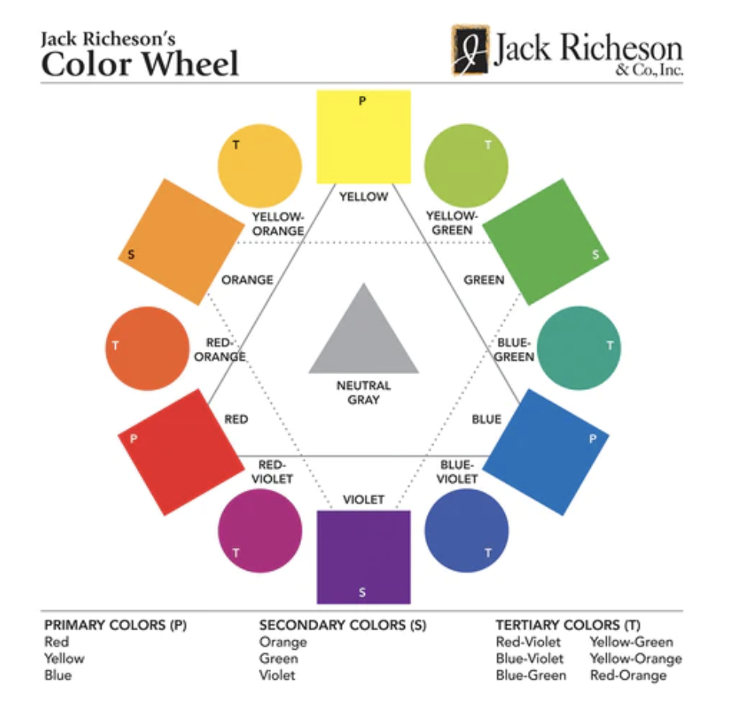
COLOR / HUE
Hue is the name we give colors – red, orange, purple, etc.
The color wheel shows the relationship between colors

Slide 3
PRIMARY COLORS
RED, BLUE, YELLOW
The three primary colors are the original parents of all other colors. You can find the primary colors on the color wheel on each end of it, equally distanced from one another.
RYB model, which applies when mixing pigments.
***RGB and CMYK models are concerned with mixing light and ink, respectively and have slightly different primary colors.

Slide 4
SECONDARY COLORS
GREEN, PURPLE, ORANGE
Secondary colors are made by combining two primary colors.
Try filling half the box with pure secondary color pencil, then try blending the two primary colors on the other side to achieve the secondary color.

Slide 5
TERTIARY OR INTERMEDIATE COLORS
GREEN, PURPLE, ORANGE
Tertiary colors are made by combining two secondary colors.
Try filling half the box with pure tertiary color pencil, then try blending the two secondary colors on the other side to achieve the tertiary color.

Slide 6
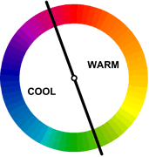
Color Temperature
Each color has a temperature. Colors nearer to the yellows and reds are said to be warm.
Colors nearer to the blues and greens are said to be cool.
Warm colors are vivid and energetic, and tend to advance in space.
Cool colors give an impression of calm, and create a soothing impression.
White, black and gray are considered to be neutral. (Values)

Slide 7
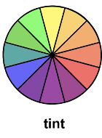
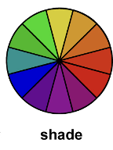
The value of the color refers to its lightness or darkness.
Adding white to a color lightens it and is called a tint.
Adding black to a color darkens it and is called a shade.

Slide 8
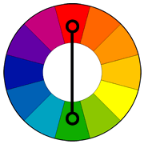
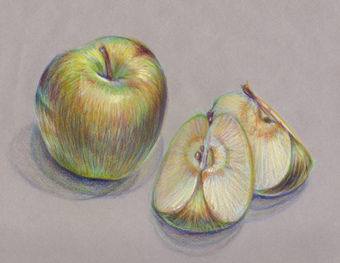
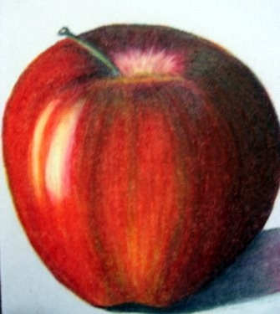
How can I make complementary colors work for me?
Complementary colors are located
across from each other on the
color wheel. They are called
complementary because when placed side by side they look good together and tend to stand out.
You can add complements (in small blended doses) for more natural color – green in a red apple or a light value lavender or violet to a yellow pair. Adding too much will dull the color.
TRY IT IN YOUR SKETCHBOOK!

Slide 9
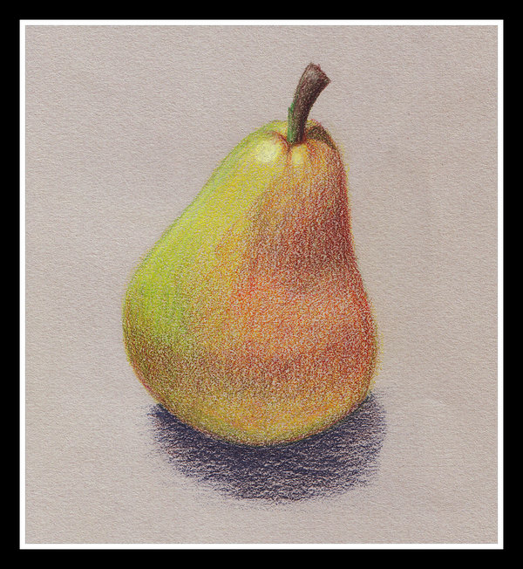
Color Intensity
A colors intensity is its degree of brightness or “chroma”.
Pure, unmixed colors are usually the most intense.
At times, you may wish to dull a too-brilliant color – you can do
this by overlaying it with another hue. This will decrease the brightness.
First, instead of using only one colored pencil to shade an entire area, we use several
different ones. For a subtle effect, adjust the intensity by using a slightly lighter and
darker shade of the same hue (basic color) as the one you wish to use, blending in
small strokes of each among the main color. The hue can also be varied, adding
adjacent colors.
For example, if I wanted to shade an area in a strong, mid yellow, I'd add hints of a
warmer orange-yellow and a cooler lemon or lime green-yellow of a similar tone.
You might use touches of orange, magenta and burgundy in an area of red. They can
be blended in or used in small strokes or dots, as in a pointillist or impressionist painting.
This stimulates more of the eye and gives the impression of brightness.
TRY IT IN YOUR SKETCHBOOK!

Slide 10
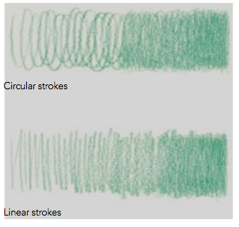
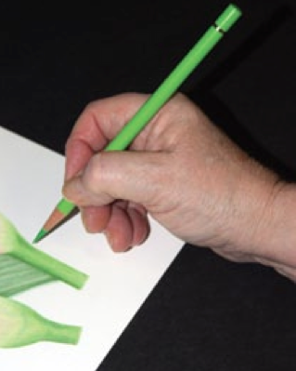
Shading techniques
Most effective strokes for layering
color with pencil
Prismacolors are meant to be layered!
How to Hold the Pencil
Both circular and linear strokes are made with
the pencil held in a normal writing position,
approximately perpendicular to the paper surface
Except in special instances, color should never be
applied with the point horizontal to the painting
surface.

Slide 11
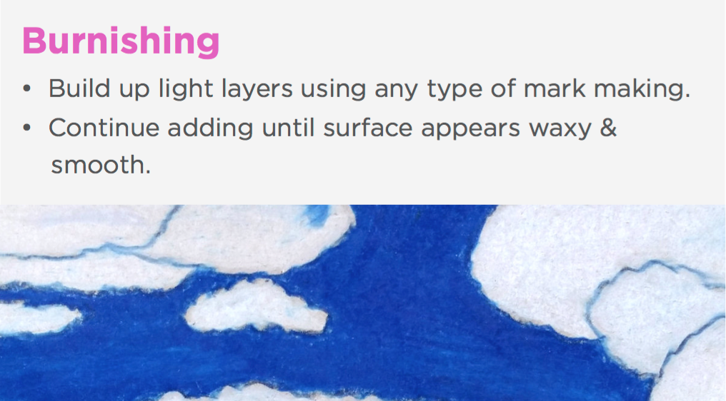

Slide 12
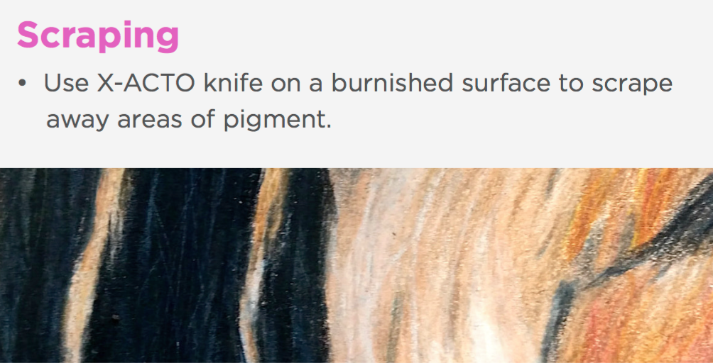

Slide 13
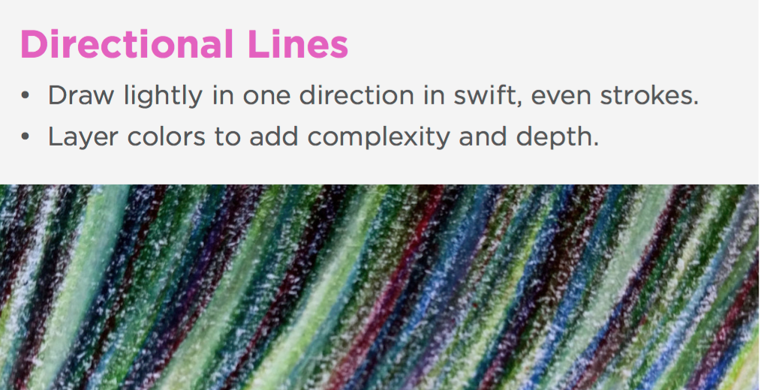

Slide 14
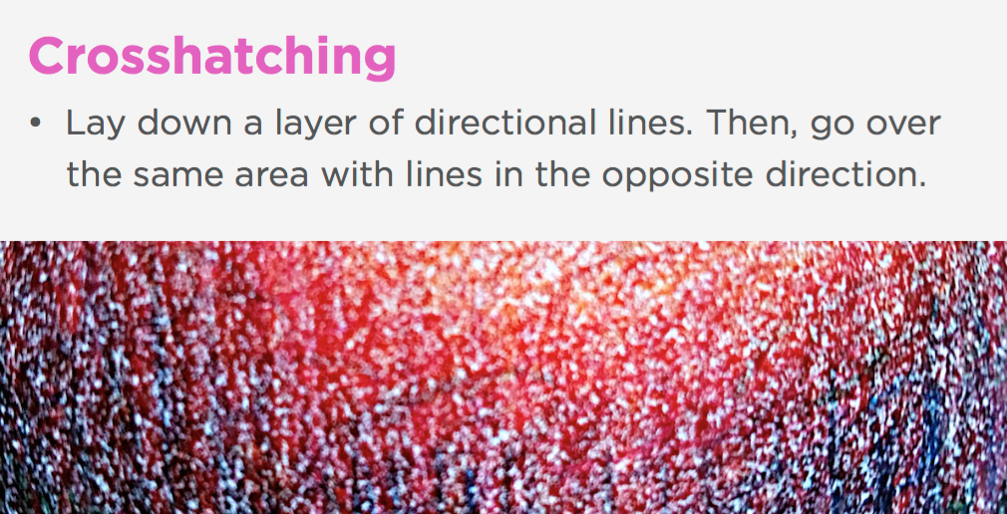

Slide 15
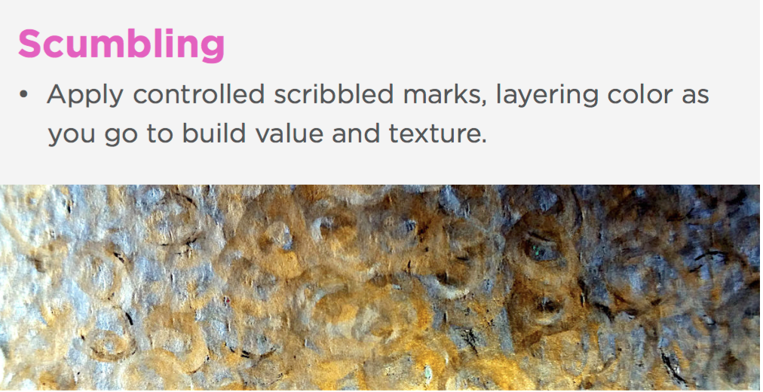

Slide 16
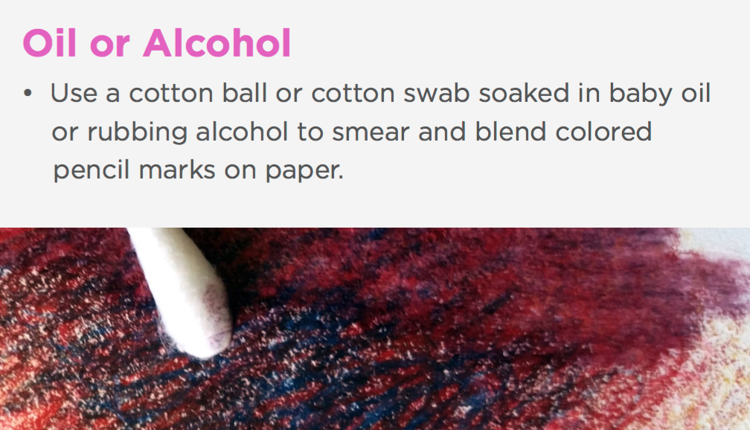

Slide 17
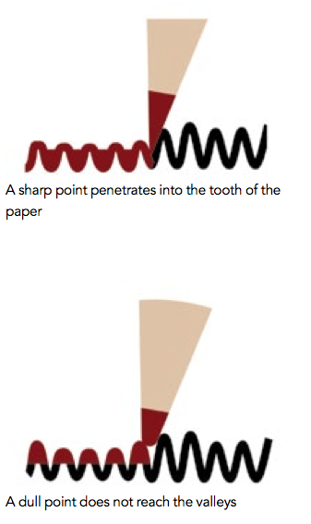
Keeping the pencil sharp allows the point to deliver the pigment into the tooth's valleys.
A dull point does not fit into the valleys, leaving them bare, which makes it seem like not
enough color is being applied. The natural response is to apply more pressure, which leads
to applying too much pigment too soon.

Slide 18

Housekeeping
Although colored pencil is probably the least messy medium, small crumbs or debris is given off the pencil as you work. Wax-based pencils, Prismacolors in par- ticular, produce more debris than oil-based. If left unattended, these tiny bits of colored pencil can lodge in the tooth of the paper, causing potential problems. For example, if you are using a red pencil and it leaves debris in an area that is intended to be painted a light color, the area can become contaminated resulting in tiny red streaks when the lighter colors are applied. Since colored pencil cannot be completely erased...you get the idea. Debris should
be removed as soon as possible with a soft brush or a spray can of compressed air.

Slide 19
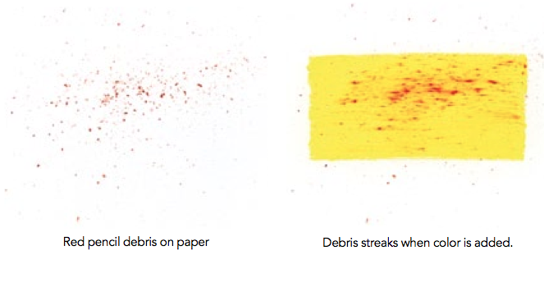

Slide 20
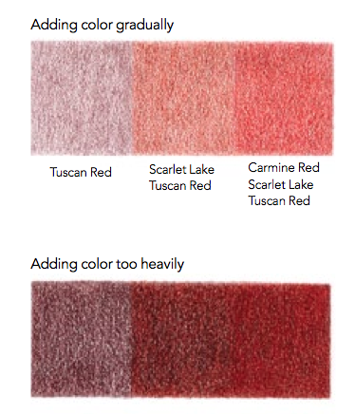
Add color gradually
Regardless of technique, color is always added gradually, with as little pressure as
possible and a needle-sharp point. Heavy application of pigment made all at once
defeats your ability to utilize colored pencil's unique translucent characteristics
because they are simply overpowered, somewhat like covering a prime steak with
a bottle of ketchup.

Slide 21
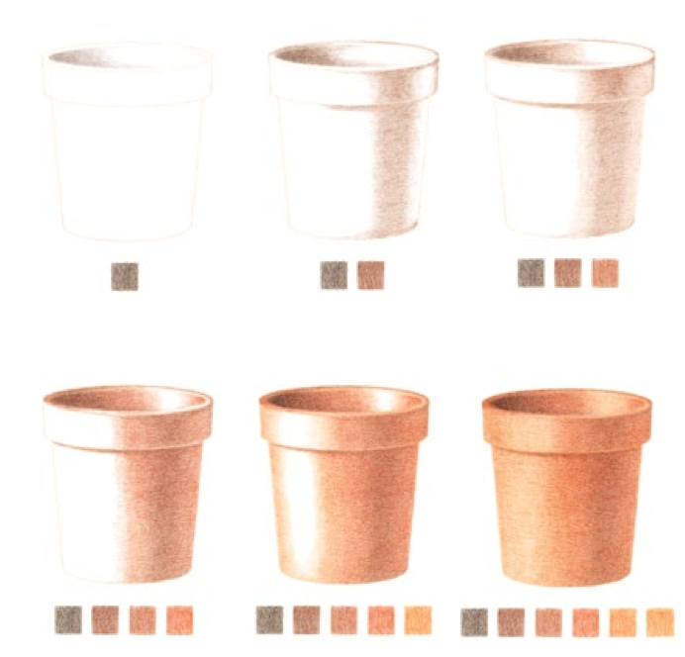
Paint the darkest value of a specific area first, and then add lighter colors on top. The colored pencil’s unique translucency allows darker values to show through lighter colors layered over them while the lighter colors retain their visibility.

Slide 22
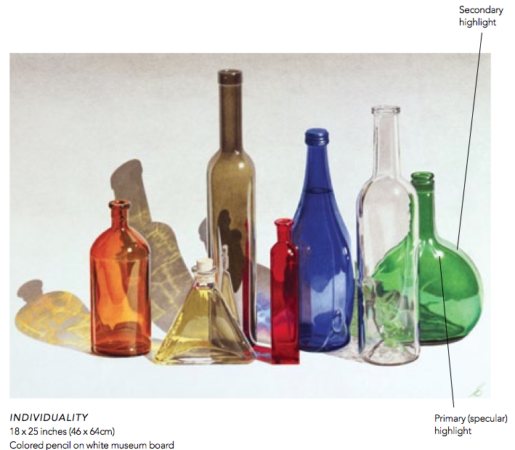
Use the White of your paper for primary highlights
When painting on white paper, leave it free of color for primary, or specular, highlights
(the bright spot of light that appears on shiny objects). Only the specular highlights in the
painting below are bare white paper. Secondary highlights (those that are not as intense)
are mostly white pencil mixed with some of the color of the immediate area.

Slide 23
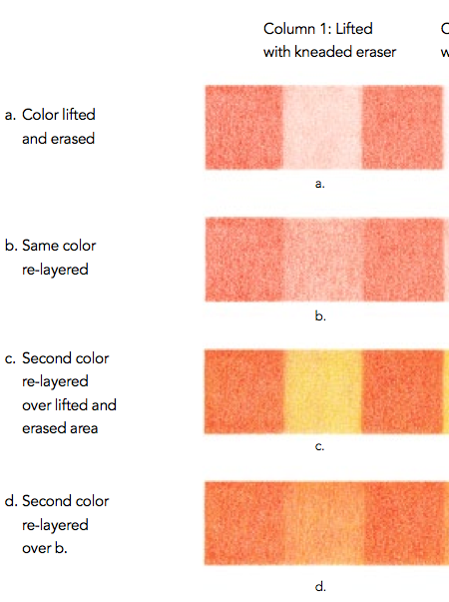
Values and hues can be adjusted by dabbing them with an eraser then re-applying color over the erased area.

Slide 24
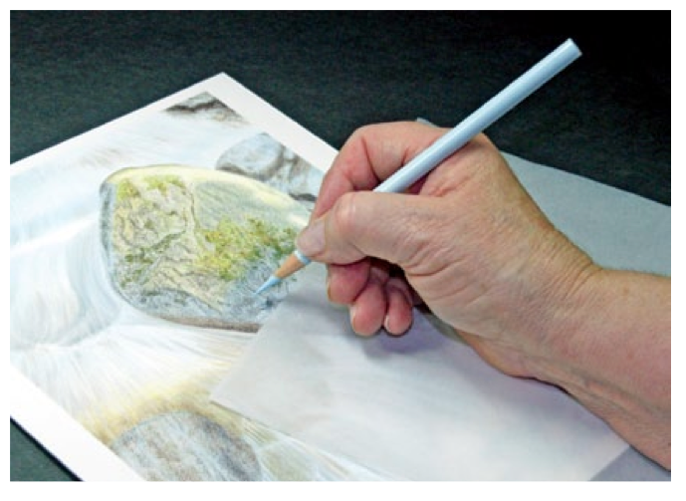
Preventing Smudging
If the heel of your hand contacts your paper on the colored areas, smudging may occur,
especially with strong colors such as reds, violets, dark blues and such. Smudging colored
pencil is minimal when compared to pastels, but if it is left unattended, smudged colored
pencil can also lead to color contamination. A sheet of tracing paper under your hand,
or not resting your hand on painted areas, prevents smudging. Light smudging can be
easily removed with a kneaded eraser.

Slide 25
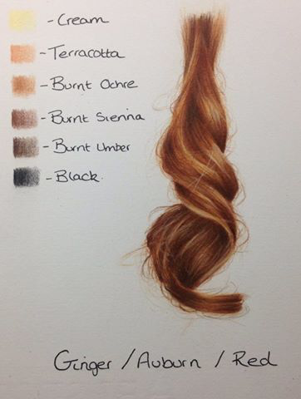

Slide 26
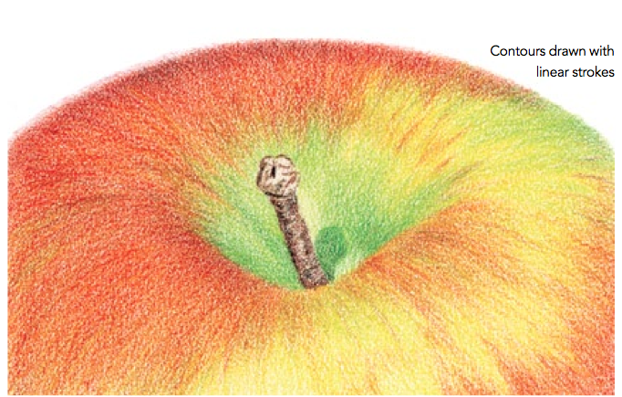
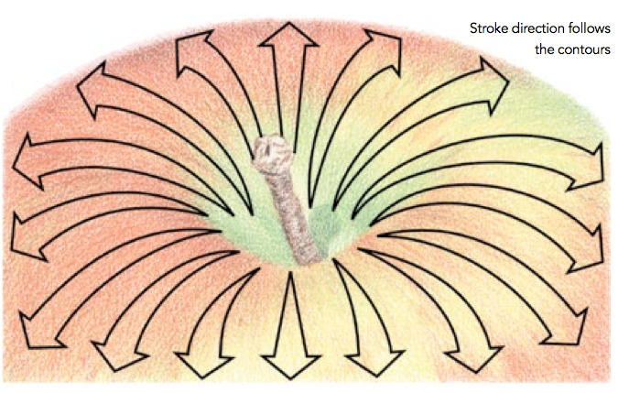
Following Contours
In order for subjects to look natural and to give them dimensionality, colored pencil
strokes should always be applied in the same direction and follow the contours, texture or grain of the subject.
https://derricktheartist.wordpress.com/2017/05/13/how-to-color-a-delicious-pink-lady-apple-with-colored-pencils/https://derricktheartist.wordpress.com/2017/05/13/how-to-color-a-delicious-pink-lady-apple-with-colored-pencils/

Slide 27
ASSIGNMENT:
Notes in sketchbook: Include practice drawings apples and pears (15 pts)

